Slide 1
Optical communications and data networks (EENGM2001) Week14_Lecture013_ASync_Beamsplitters
Siddarth K Joshi

Slide 2
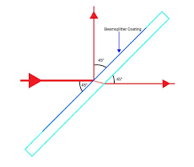
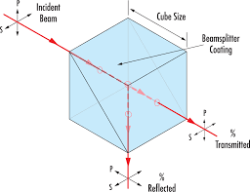
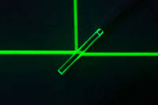
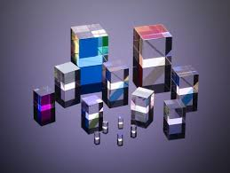
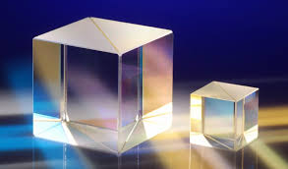
Beam Splitter
Optical device to change the direction of a fraction of the input power.
Not dependent on wavelength, polarisation, etc.
Only in the ideal case

Slide 3
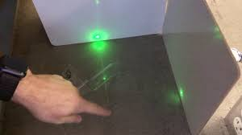
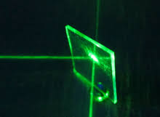
Beam Splitter
Splitting ratio, can be chosen.
Most common is 50:50
Also called 3dB coupler.
Used in interferometers,
Duplicating an optical signal
All copies of the signal will have a lower transmit power than the original.

Slide 4
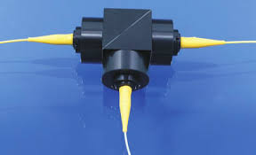
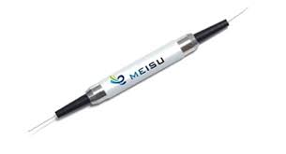
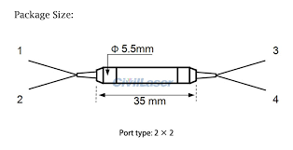
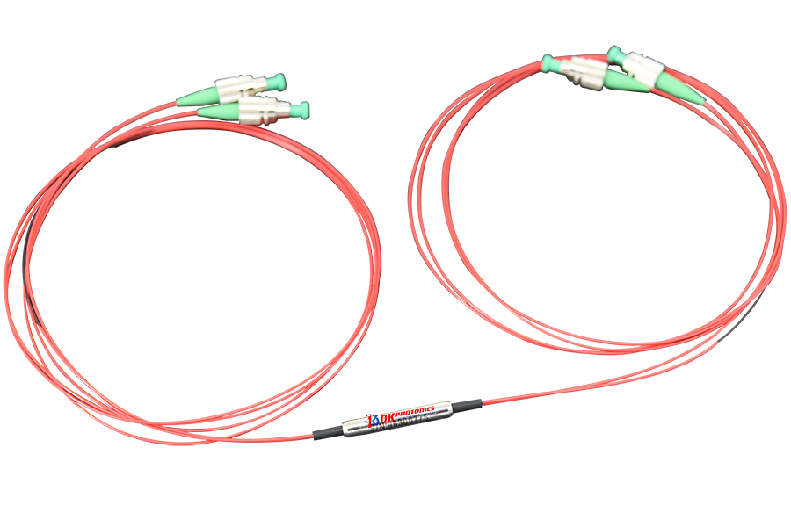
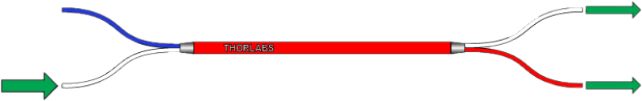
Beam Splitter
Can be a fibre device as well
This is a very expensive way to make a BS.

Slide 5
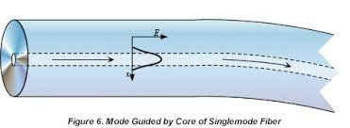

Evanescent field
Light travelling in a waveguide has an electric field that extends to infinity.
Too far from the edge the field is too weak to consider.
But very close to the edge, there is a measurable field – the Evanescent field

Slide 6
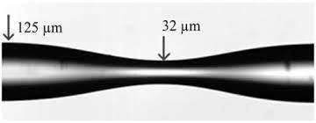
Tapering
The field strength of light does not change based on the single mode core diameter.
Remember, in Async lecture005_fibre, we studied that the core size only dictates the lower cut off wavelength.
Any wavelength longer than that will be single mode.
But the loss will be very high.
The loss mechanism is the Evanescent field

Slide 7
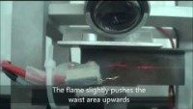
Tapering
The field strength of light does not change based on the single mode core diameter.

Slide 8
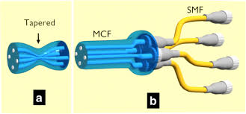
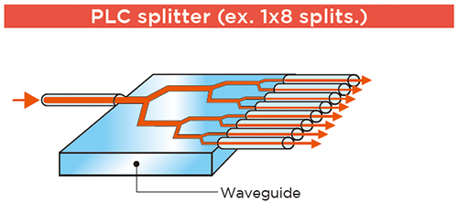
Beam Splitter

